Slide 1

AydnLabs Presents
Aydnflow
Empowering businesses in the MENA Region with autonomous, native AI agents for Sales & Support

Slide 2

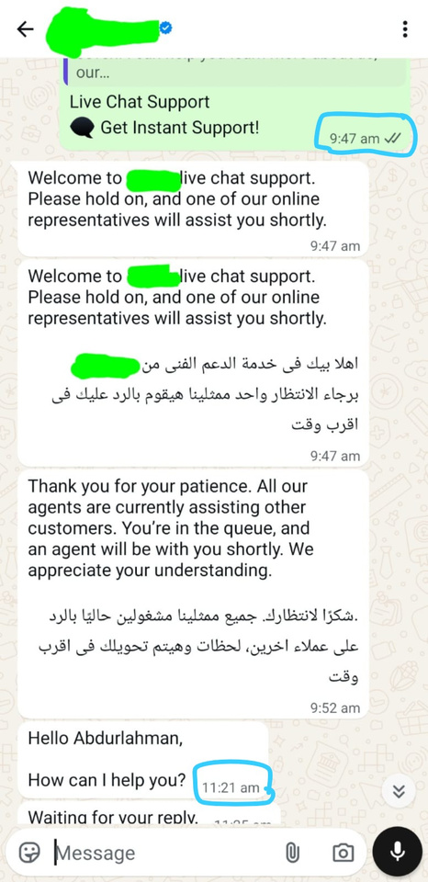

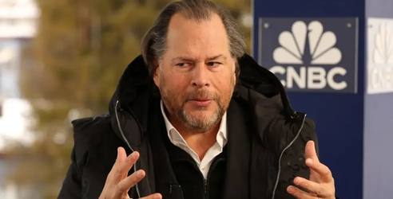
The High Cost of Human Constraints
Marc Benioff
CEO of Salesforce
“Thousands… hundreds of thousands of leads have never been called back. In the agentic world, there’s no excuse for that. Every lead can be followed up on.”

Slide 3
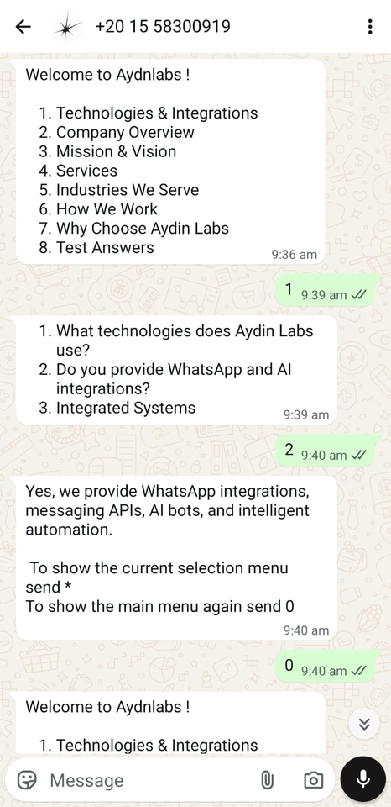
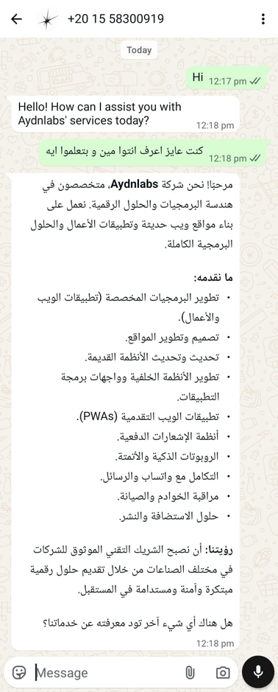
Meet AYDNFLOW
Multi-lingual AI Agent
A tireless, bilingual digital workforce that never sleeps — built to understand your customers the way your best agents would.
Instant Responses
Zero wait times.
Zero missed opportunities.
15+ Arabic Dialects
Native understanding not translation, true localization.

Slide 4


Most AI models are English-first. In Arabic, they collapse, mixing dialects and breaking customer trust.
Built for Arabic
English Logic, Arabic Words
لا يعتمد علي الترجمه فقط
Thinks in English
Translates to Arabic

Slide 5
WHY AYDNFLOW
Infinite Scale, Predictable Costs.
Generative AI Mode
  Fluid, human-like conversations for complex sales and support.
Deterministic Template Mode
  Rule-based, auditable workflows for regulated transactions.
Smart Subscription Quotas
  Your tier powers a set volume of Generative AI interactions.
Zero-Downtime Fallback
  Exceed your AI quota? The system instantly falls back to Template Mode.
The Business Impact
100% uptime for your customers. Zero hidden inference costs or runaway token bills for you.

Slide 6
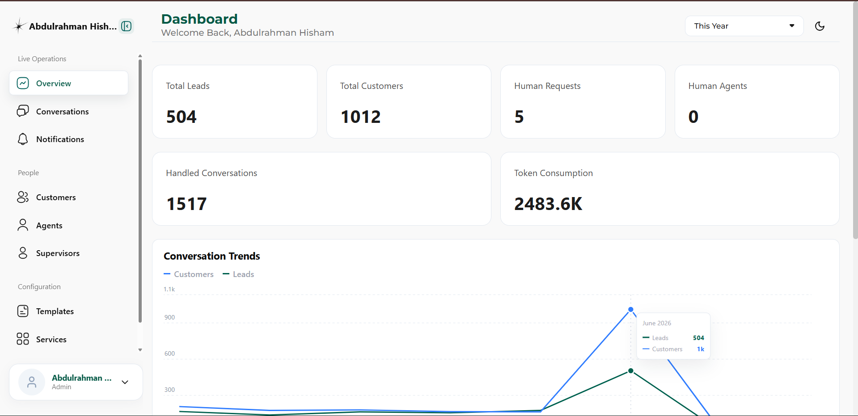

Slide 7
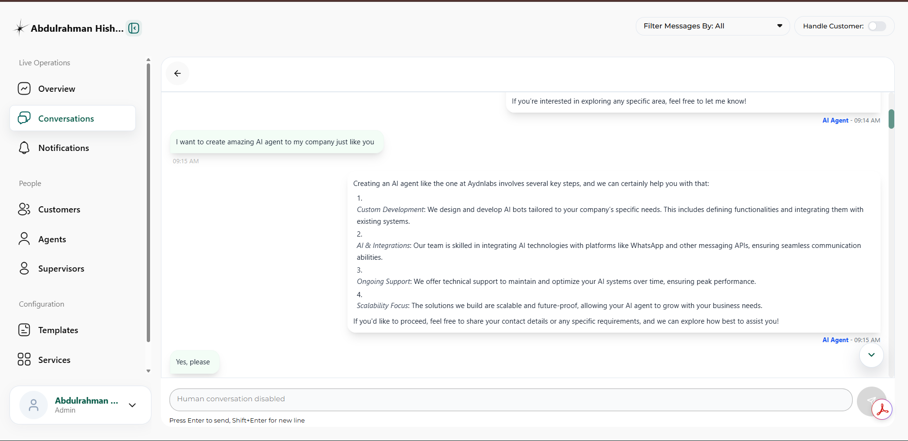

Slide 8
AydnFlow as a service
Limited
Starter
Professional
1 human seat
Limited web widget
Template Mode
150 AI chat credits.
5 concurrent customers
2 human seats
web widget
Unlimited Template Mode
1,000 AI chat credits.
12 concurrent customers
5 human seats
web widget
CRM sync
WhatsApp/Telegram integration
Unlimited Template Mode
3,000 AI chat credits.
30 concurrent customers
$0.015 per client for each extra client to handle
$0.06 per chat credit
Extra human seat: $5/mo
$0.010 per client for each extra client to handle
$0.04 per chat credit
Extra human seat: $5/mo
$0
$40
$100
per month
per month

Slide 9
The True Cost of Human-Centric Support
Scaling to 10,000 clients (3,300 tickets/mo) requires 15 full-time agents.
Human-Centric Customer Service
AYDNFLOW
15 Full-Time Agents
3 Human Agents
3 QA managers
Enterprise solution
  Starts at $8,000 USD / year
  20% Upfront
  Zero hiring hustle. Instant 24/7 response.
  Humans only handle high-value escalations.
  $53,000 USD / year
  $12k Upfront (CapEx)
  High churn, hiring hustle
  Delayed off-hour response times.
Save $35,000 annually, eliminate 80% of hiring overhead, and achieve 100% uptime
(Not ready for an Enterprise deployment? Scale at your own pace with our standard SaaS tiers).

Slide 10
Brought to you by
AYDNLABS
Building MENA region AI infrastructure
Goal
Our mission is to develop homegrown, MENA-focused technology solutions that give organizations more control, stronger localization, and no dependence on external systems.
Future
Become the leading company in this Arab technological breakthrough, helping the Arab world build its own intelligent software stack with full control, localization, and long-term independence.

